Slide 1


Event Table
Event | Trigger | Source | Use Case | Response | Destination
VCM and Server Key generates key using Diffie-Hellman Algorithm | Server Key collects all public keys of VCMs | VCM and Server Key | Generate key using Diffie-Hellman Algorithm | Generated Key | VCM
VCM encrypts ER using VCM’s private key | Generated key using Diffie-Hellman Algorithm | VCM | Encrypt ER using private key | Encrypted ER | VCM
VCM gets hash value of ER using three hash function | Encrypted ER | VCM | Hash the ER | Three hash values of ER | VCM
VCM encrypts the encrypted ER and hash values together using the generated key in the Diffie-Hellman Algorithm | Hash values of ER | VCM | Encrypt the encrypted ER and its hash values together | Encrypted encrypted ER and hash values | VCM
VCM sends both the encrypted encrypted ER and its three hash values to Server Key | Encrypted encrypted ER and hash values | VCM | Send both the encrypted encrypted ER and its hash values | Sent encrypted encrypted ER and hash value | Server
Server Key receives the data and decrypts it using the Diffie-Hellman Key and the VCM’s public key | Sent encrypted encrypted ER and hash value | Server Key | Decrypt data using Diffie-Hellman Key and VCM’s public key | Decrypted ER and its hash function | Server
Server key hashes the decrypted ER | Decrypted data | Server Key | Hash the decrypted ER | Three hash values of the decrypted file | Server
Server key checks if the generated hash values of the file and the hash values sent by the VCM are the same | Three hash values of the decrypted file | Servery Key | Server key checks if hash values are the same | Verified data | Server

Slide 2
Context Diagram
Encrypted data
VCM
Automated Election System
Encrypted data
Servers(CSS,Central and Transparency)
Encrypted data
Encrypted data

Slide 3
DFD DIAGRAM 0
4
encrypts the encrypted ER and hash values together using the generated key in the Diffie-Hellman Algorithm
generated key
2
Encrypts ERs using VCM’s private key
3
Gets hash value of ER using three hash function
Hash value of ER
encrypted ER
1
Generates key using Diffie-Hellman Algorithm
encrypted encrypted ER &
three hash values
Public keys
6
decrypts encrypted ERs using the Diffie-Hellman Key and the VCM’s public key
encrypted encrypted ERs and three hash values
5
sends both the encrypted encrypted ER and its three hash values to Server Key
8
checks if the generated hash values of the ER and the hash values sent by the VCM are the same key
hashed decrypted ER
7
hashes the decrypted ER
decrypted ERs

Slide 4
DFD DIAGRAM 1

Slide 5
Activity Diagram
VCM | SERVER
Generates key
Sends both the encrypted encrypted ER and its hash values
Encrypt ER using private key
Decrypts data using Diffie-Helman key and VCM’s public key
Gets hash values of ER
Hash the decrypted ER
checks if the generated hash values of the ER and the hash values sent by the VCM are the same
Encrypts the encrypted ER and its hash values together

Slide 6
Communication Diagram
1:GenerateKey()
5:SendEncryptedER
& HashValue()
:VCM
:Servers
(CCS, Central and Transparency)
2:EncryptERs()
6:DecryptER()
7:HashDecryptedER()
8:CheckHashValues()
3:GetHashValue()
4:EncryptEncryptedER
& HashValue()

Slide 7
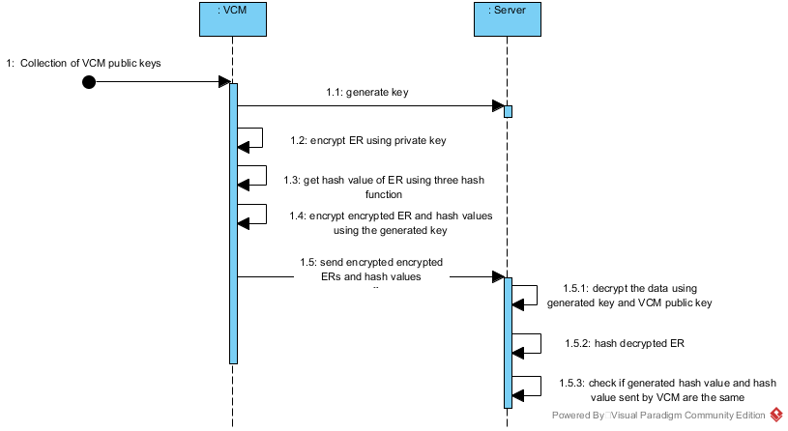
Sequence Diagram

Slide 8
State Diagram
VCM public key
Generate key
Decrypt ER
Hash decrypted ER
Generated key
Generated key
Public key
Encrypt ER
Send encrypted ER and hash values
Check hash values
Encrypted ERs
Get hash value
Generated key
Encrypt encrypted ER and hash values

Slide 9
Timing Diagram
Generate key using DH algorithm
Encrypt ER using VCM public key
Get hash value of ER
Encrypt the encrypted ER and hash values together using the generated key in the Diffie-Hellman Algorithm
|------30s------|--------30s-------|-------30s------|-----------------30s---------------------|
Send encrypted encrypted ERs & hash value
Decrypt encrypted ER using DH key & VCM private key
Hash decrypted ER
Check if generated hash values of the file and the hash values sent by the VCM are the same key
|--------30s---------|-----------30s---------|-------30s-------|----------------30s-----------------|

Slide 10
Interaction Overview Diagram
Sd VoteTransmission

Slide 11
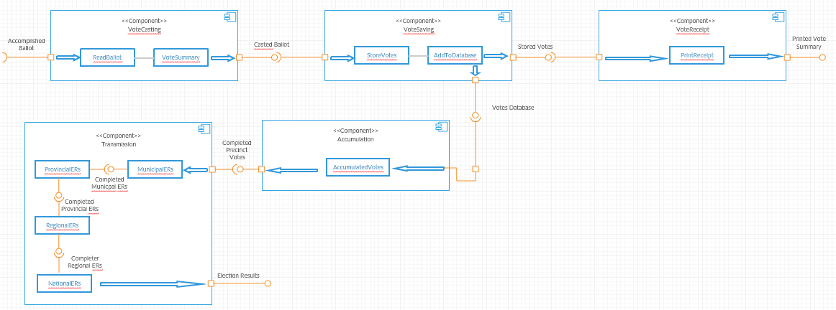
Component Diagram

Slide 12
Composite Diagram
TransmissionVotes
Central Server
VCM
Transparency Server
Hybrid Cryptography of AES
Transparency Server

Slide 13
Use Case Diagram
VCM
Generate key
CCS, Central, Transparency Server

Slide 14
Use Case Diagram
VCM
Encrypt ER

Slide 15
Use Case Diagram
VCM
Get hash value of ER

Slide 16
Use Case Diagram
VCM
Encrypt encrypted ER and hash values

Slide 17
Use Case Diagram
VCM
Send encrypted encrypted ER and three hash values
CCS, Central, Transparency Server

Slide 18
Use Case Diagram
CCS, Central, Transparency Server
Receive data and decrypt ER

Slide 19
Use Case Diagram
CCS, Central, Transparency Server
Hash decrypted ER

Slide 20
Use Case Diagram
CCS, Central, Transparency Server
Verify if hash values matched

Slide 21
Use Case Diagram w Full Description
Use Case Name: | Generate key using Diffie-Hellman Algorithm
Scenario: | VCM and Server will generate key using Diffie-Hellman Algorithm
Triggering Event: | End of voting period
Brief Description: | All VCM public keys are collected by the servers
Actor(s): | VCM, CCS, Central Server, Transparency Server
Related Use Cases: | ---
Stakeholders: | The VCM will receive the data sent by the servers The three servers will have to send the encrypted data
Precondition: | Voting Period closes
Postcondition: | Generated a key
Basic Flow: | Actor: 1. The Comelec closes the voting period | System Response: 1.1 The three servers(CCS, Central Server and Transparency Server) and the VCM will generate a shared key using the Diffie-Hellman
Exceptions: | The machines being used have defects making it impossible to communicate

Slide 22
Use Case Diagram w Full Description
Use Case Name: | Encrypt ER using private key
Scenario: | VCM encrypts the data using its private keys
Triggering Event: | Received generated key
Brief Description: | In order for the VCM to send the data, it has to encrypt it using its very own private key.
Actor(s): | VCM, CCS, Central Server, Transparency Server
Related Use Cases: | Generate key using Diffie-Hellman Algorithm
Stakeholders: | The VCMs must encrypt the data using the private key assigned to it
Precondition: | Collects all ERs
Postcondition: | Encrypted the data
Basic Flow: | Actor: 1. The VCM will ensure the encryption of election return using its private key | System Response: 1.1 The System will encrypt the data.
Exceptions: | The machines being used have defects making it impossible to communicate. Human intervention is present and the system fails to serve its purpose.

Slide 23
Use Case Diagram w Full Description
Use Case Name: | Hash the ER
Scenario: | VCM hash the ER using the Diffie-Hellman algorithm
Triggering Event: | Successfully encrypted data
Brief Description: | A security algorithm is used by the VCM in order to hash the three hash values of the ER
Actor(s): | VCM, CCS, Central Server, Transparency Server
Related Use Cases: | Generate key using Diffie-Hellman Algorithm Encrypt ER using private key
Stakeholders: | The VCM must be able to hash the ER
Precondition: | Encrypted ER
Postcondition: | Hashed ER
Basic Flow: | Actor: 1. To further protect the election return, VCM will use three hash functions | System Response: 1.1 VCM will hash the election returns to be able to get its hash values.
Exceptions: | The machines being used have defects making it impossible to communicate. Human intervention is present and the system fails to serve its purpose.

Slide 24
Use Case Diagram w Full Description
Use Case Name: | Encrypt the encrypted ER and its hash values together
Scenario: | VCM encrypts encrypted election returns and hash values in a single encrypted file
Triggering Event: | Encrypted ER and its hash values
Brief Description: | After the VCM hash the ER’s hash value, the VCM will encrypt the encrypted ER and its hash values together
Actor(s): | VCM, CCS, Central Server, Transparency Server
Related Use Cases: | Generate key using Diffie-Hellman Algorithm Encrypt ER using private key Hash the ER
Stakeholders: | VCM should hash the election returns before encrypting it again
Precondition: | Hash values of the ER
Postcondition: | Encrypted encrypted election returns and its hash values
Basic Flow: | Actor: The VCM will make sure that before the second encryption, the file is already encrypted | System Response: 1.1 Encrypted election returns and its hash values will be encrypted using Diffie- Hellman algorithm. 1.2 In the event that there was an anomaly in the hash, the servers won’t accept the data thus calling the attention of the administrators.
Exceptions: | The machines being used have defects making it impossible to communicate. Human intervention is present and the system fails to serve its purpose.

Slide 25
Use Case Diagram w Full Description
Use Case Name: | Send both the encrypted encrypted ER and its hash values
Scenario: | The encrypted encrypted ER and its hash values will be sent to the server key
Triggering Event: | Encrypted encrypted election returns and hash values
Brief Description: | Sent the encrypted encrypted ER and hash values to the server to be able to decrypt it.
Actor(s): | VCM, CCS, Central Server, Transparency Server
Related Use Cases: | Generate key using Diffie-Hellman Algorithm Encrypt ER using private key Hash the ER Encrypt the encrypted ER and its hash values together
Stakeholders: | Servers will receive the encrypted data set by the VCM
Precondition: | Sent encrypted ERs and hash values
Postcondition: | Received encrypted ERs and hash values
Basic Flow: | Actor: 1. VCM will make sure that there are no intervention in the transmission process | System Response: 1.1 The VCM will send the data to the server 1.2 Servers will receive the encrypted file 1.3 In the event that there was an anomaly in the hash, the servers won’t accept the data thus calling the attention of the administrators.
Exceptions: | The machines being used have defects making it impossible to communicate. Human intervention is present and the system fails to serve its purpose.

Slide 26
Use Case Diagram w Full Description
Use Case Name: | Decrypt data using Diffie-Hellman Key and VCM’s public key
Scenario: | CCS, Central Server and, Transparency Server decrypt the data using the DH key and the VCM’s public key
Triggering Event: | Receiving of the Encrypted data
Brief Description: | Server will decrypt the election returns
Actor(s): | VCM, CCS, Central Server, Transparency Server
Related Use Cases: | Generate key using Diffie-Hellman Algorithm Encrypt ER using private key Hash the ER Encrypt the encrypted ER and its hash values together Send both the encrypted encrypted ER and its hash values
Stakeholders: | Servers will decrypt the data using the generated key and the public of a certain VCM
Precondition: | Sent encrypted ERs
Postcondition: | Decrypted ERs
Basic Flow: | Actor: 1. Server decrypts the file being sent by the VCM | System Response: 1.1 The servers will encrypt the file using the generated key and the VCM’s public key 1.2 If the VCM and the server do not have the same generated key, the server cannot decrypt the file 1.3 In the event that there was an anomaly in the hash, the servers won’t accept the data thus calling the attention of the administrators.
Exceptions: | The machines being used have defects making it impossible to communicate. Human intervention is present and the system fails to serve its purpose.

Slide 27
Use Case Diagram w Full Description
Use Case Name: | Hash the decrypted ER
Scenario: | CCS, Central Server and, Transparency Server will hash value of the received election returns
Triggering Event: | Decrypted election returns
Brief Description: | Received encrypted election returns
Actor(s): | VCM, CCS, Central Server, Transparency Server
Related Use Cases: | Generate key using Diffie-Hellman Algorithm Encrypt ER using private key Hash the ER Encrypt the encrypted ER and its hash values together Send both the encrypted encrypted ER and its hash values Decrypt data using Diffie-Hellman Key and VCM’s public key
Stakeholders: | Servers will determine if the hash values are authentic
Precondition: | Sent encrypted ERs
Postcondition: | Verified Hash Value
Basic Flow: | Actor: 1. Server will automatically hash the decrypted election returns for verification | System Response: 1.1 The servers will check the ER’s integrity by finding the hash values. 1.2 In the event that there was an anomaly in the hash, the servers won’t accept the data thus calling the attention of the administrators.
Exceptions: | The machines being used have defects making it impossible to communicate. Human intervention is present and the system fails to serve its purpose.

Slide 28
Use Case Diagram w Full Description
Use Case Name: | Server key checks if hash values are the same
Scenario: | CCS, Central Server and, Transparency Server verify hash value of the received election returns
Triggering Event: | Hash values of decrypted election returns
Brief Description: | Received encrypted election returns
Actor(s): | VCM, CCS, Central Server, Transparency Server
Related Use Cases: | Generate key using Diffie-Hellman Algorithm Encrypt ER using private key Hash the ER Encrypt the encrypted ER and its hash values together Send both the encrypted encrypted ER and its hash values Decrypt data using Diffie-Hellman Key and VCM’s public key Hash the decrypted ER
Stakeholders: | Servers will determine if the hash values are authentic
Precondition: | Sent encrypted ERs
Postcondition: | Verified Hash Value
Basic Flow: | Actor: 1. After hashing, the server will compare the hash values of decrypted fie to the hash values sent by the VCM | System Response: 1.1 If the hash values did not match, it is automatically known to be tampered. 1.2 In the event that there was an anomaly in the hash, the servers won’t accept the data thus calling the attention of the administrators.
Exceptions: | The machines being used have defects making it impossible to communicate. Human intervention is present and the system fails to serve its purpose.

Slide 29
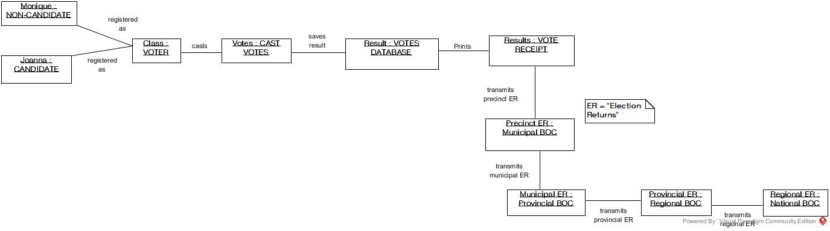
Object Diagram

Slide 30
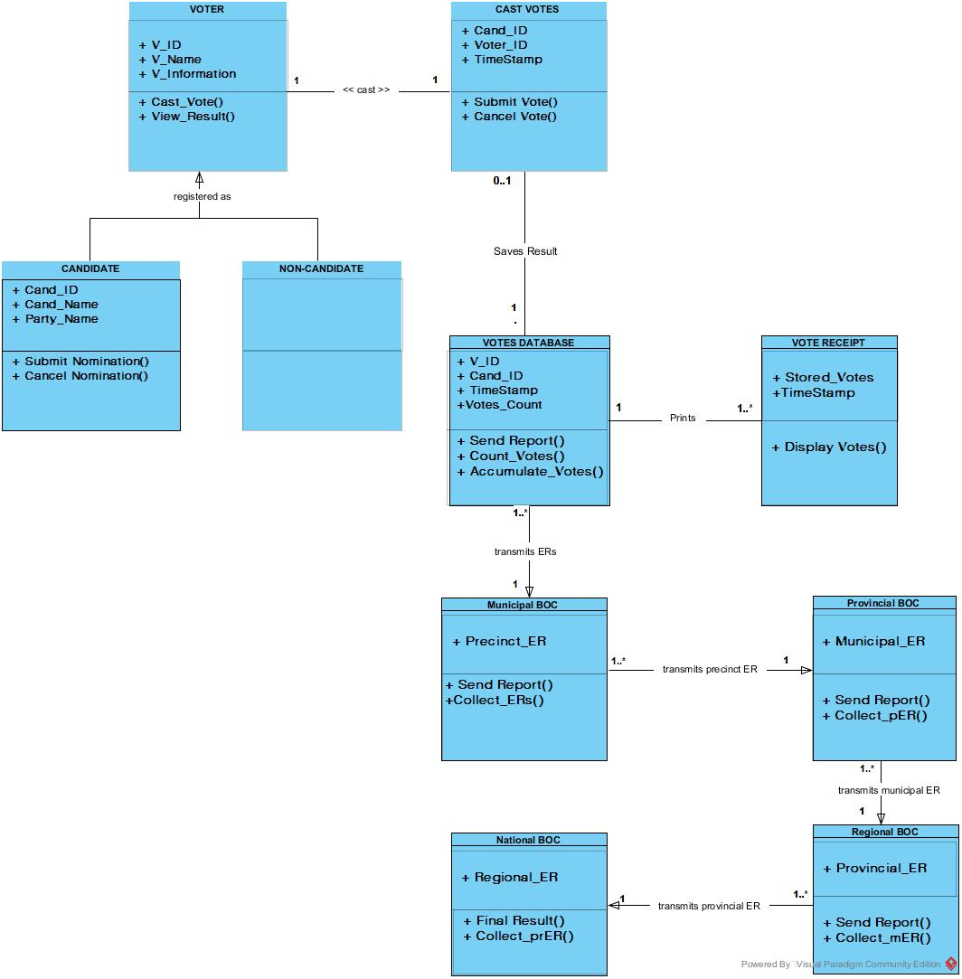
Class Diagram

Slide 31
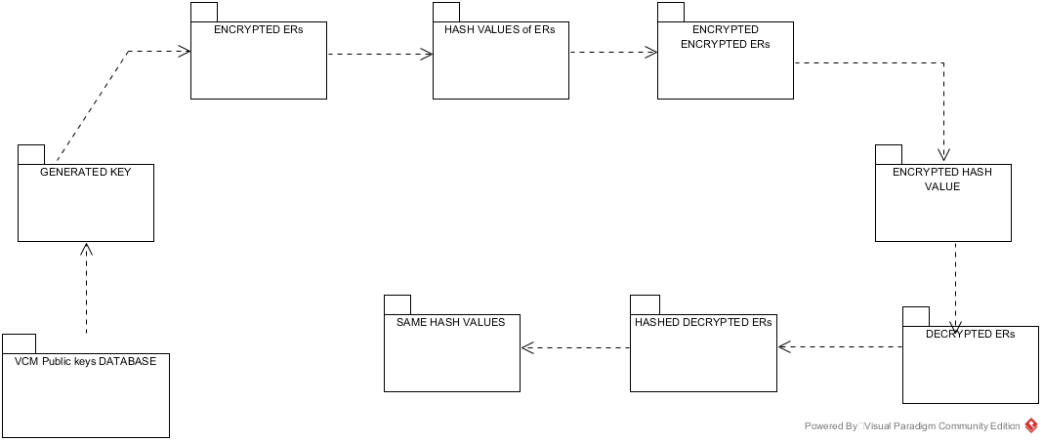
Package Diagram

Slide 32
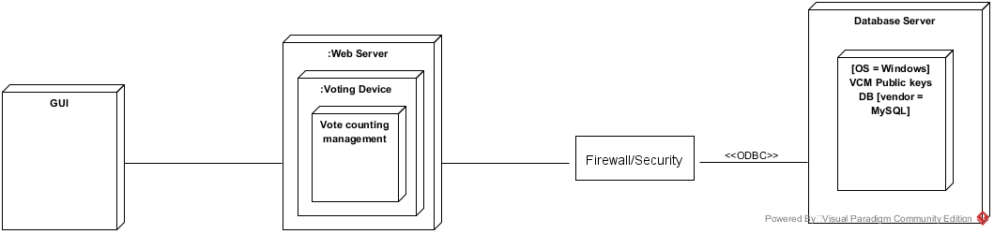
Deployment Diagram

